Slide 1
Group C Project Documentation
Kehinde Ologun | Olaniyi Olutola | Patricia Ajisafe | Tanatswa Changa | John Adeniyi | Opeayo Oshinkoya
Deployment of Random Quote Generator on Apache Web Server on AWS

Slide 2
Outline
What is Apache Web Server?
Advantages of Using AWS for Apache Web Server Deployment
Infrastructure Provisioning with Terraform
High Availability and Scalability with Apache Web Server on AWS
Security and Access Controls for Apache Web Server Deployment on AWS
Monitoring and Logging Capabilities
Best Practices and Lessons Learned

Slide 3

What is Apache Web Server?
A popular open-source web server called Apache HTTP Server. Serves various materials, apps, and websites via the internet. Processes HTTP requests and returns requested web content (HTML files, images, other media).

Slide 4

Advantages of Using AWS for Apache Web Server Deployment
Scalability
Ease of Management
AWS offers highly scalable infrastructure.
Easily adjust CPU, memory, and storage resources.
Automatically handles higher loads during traffic surges.
Simplifies management of servers and networking components.
Focus on configuring Apache and optimizing web applications.
AWS Elastic Beanstalk streamlines deployment and scaling processes.
High Availability
AWS provides redundancy across multiple data centers (Availability Zones).
Ensures continued accessibility during zone failures.
Contributes to high availability and reliability.

Slide 5
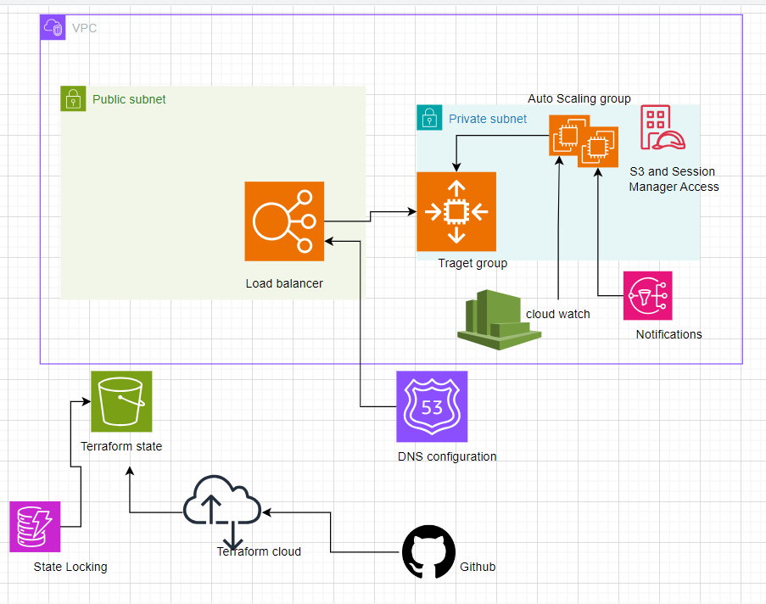
Project Architecture diagram
https://github.com/rilwan-o/ApacheWebserverDeploymentonAWSusingTerraformIaC

Slide 6
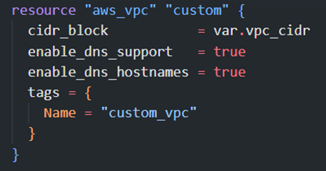
Infrastructure Provisioning with Terraform
Infrastructure as Code (IaC)
- Treats infrastructure setup as a software development process.
- Uses declarative configuration files for designing infrastructure.
- Allows version control, automation, consistency, and reduces human error.
Terraform Basics
Providers | Connects with cloud platforms like AWS
 | Manages resources across different environments.
Configuration | Written in HashiCorp Configuration Language (HCL).
 | Defines resources like VPCs, security groups, EC2 instances.
Workflow | Initialize: Set up necessary plugins (providers).
 | Plan: Preview changes based on configuration files.
 | Apply: Execute planned changes, create/update resources.
Example Terraform code snippet

Slide 7
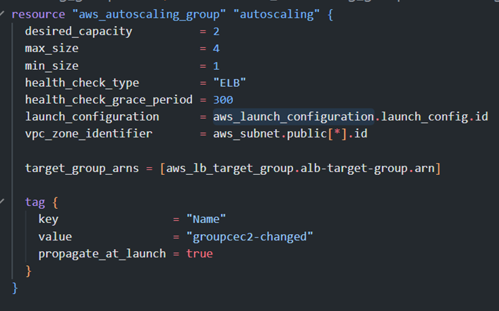
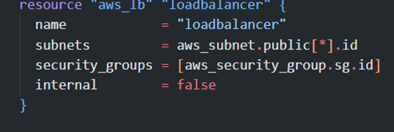
High Availability and Scalability with Apache Web Server on AWS
Auto Scaling Groups (ASGs)
Application Load Balancer (ALB)
Automatically adjusts number of EC2 instances based on traffic.
Distributes incoming traffic across multiple instances.
Ensures continued service if one instance fails.

Slide 8


Security and Access Controls for Apache Web Server Deployment on AWS
Restrict inbound traffic to necessary ports (HTTP/HTTPS).
Limit access by specifying IP ranges.
Configuring Security Groups
Implementing SSL/TLS Encryption
Use AWS Certificate Manager (ACM) for SSL/TLS certificates.
Configure ALB to handle HTTPS traffic.
Managing Access Control Using IAM Roles and Policies
Assign roles to EC2 instances for secure interactions with AWS services.

Slide 9

Monitoring and Logging Capabilities
TOOLS: CloudWatch
Benefits
Monitor server metrics (CPU usage, disk I/O, network traffic).
Set up alarms for proactive actions.
Performance Optimization: Identify and optimize resource usage.
Troubleshooting: Detailed logs for quick issue resolution.
Security Monitoring: Detect and mitigate security threats.

Slide 10
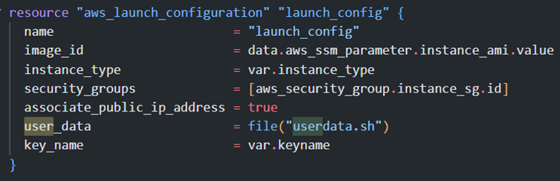
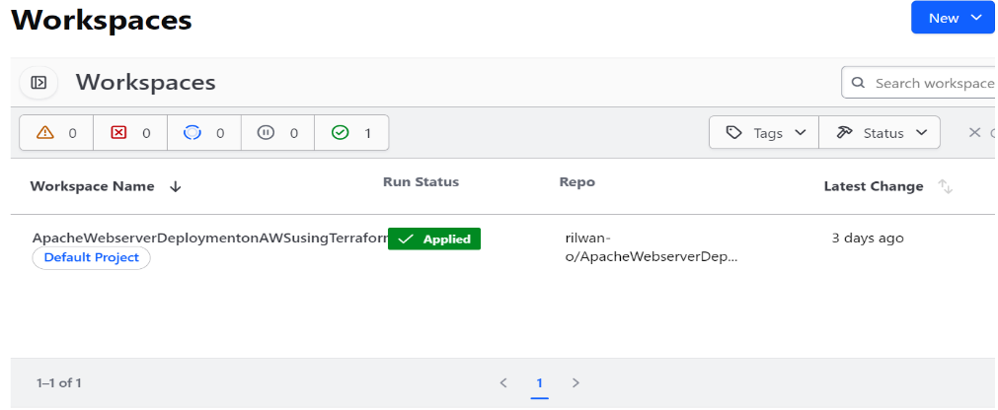
Deployment Automation and Infrastructure Updates
Automation with Terraform
Automate Deployment
CI/CD Integration
Version Control: Integrate with Github for version control, allowing you to track changes and collaborate on Terraform configurations.
CI/CD Pipeline Tools: Use Terraform Cloud to trigger infrastructure updates automatically.
Use Terraform to define and automate the entire deployment process, ensuring consistency and reducing manual errors.
Example Terraform Launch configuration snippet
Terraform cloud workspace

Slide 11
Deployment Automation and Infrastructure Updates
Backup Strategies
Amazon S3 for Backups
EC2 Snapshots
Store backups of important data in Amazon S3 for durability and accessibility.
Command: aws s3 cp /path/to/backup s3://your-bucket-name/backup/
Create snapshots of EC2 instances to easily restore the entire state of the server:
Command: aws ec2 create-snapshot --volume-id vol-xxxxxxxx --description "Backup snapshot"

Slide 12
Best Practices and Lessons Learned
Best Practices
Optimize Apache Performance
Regular Updates and Patches:
Keep the Apache server and other software up-to-date to ensure security and performance.
Tune Apache settings like MaxRequestWorkers and KeepAliveTimeout to improve performance.
Regular Updates and Patches:
Use Terraform modules to create reusable and maintainable infrastructure code.

Slide 13
Best Practices and Lessons Learned
Lessons Learned
Thorough Testing
Continuous Monitoring and Improvement
Test the entire deployment process thoroughly before going live to avoid unexpected issues.
  Use metrics and logs to continuously monitor the infrastructure and improve performance and reliability.
  Integrate with AWS CloudWatch to monitor server performance and set up alerts for critical metrics

Slide 14
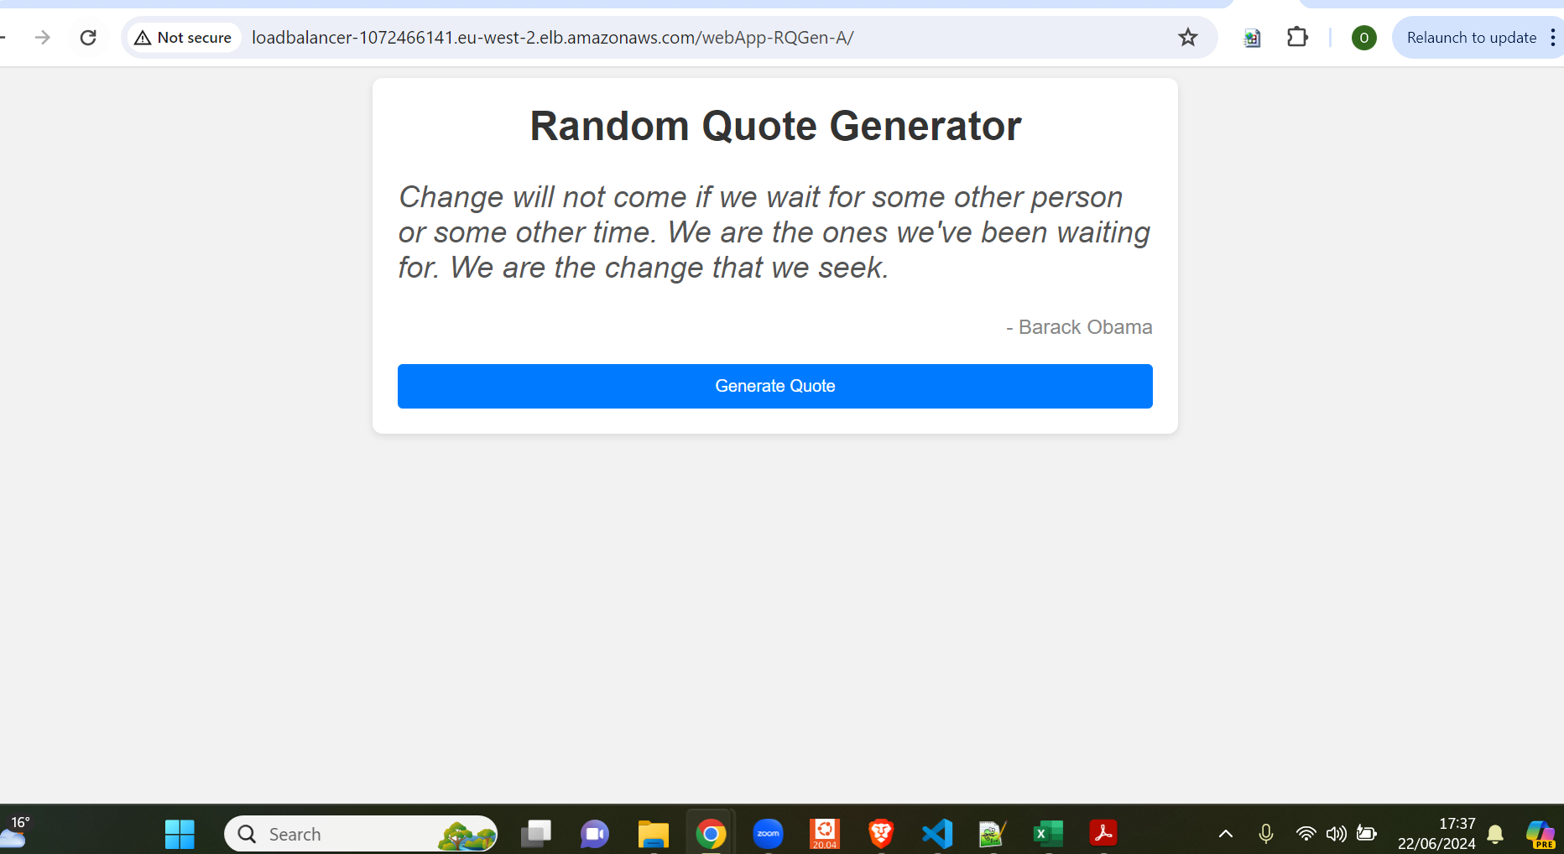
Diagram of the final Application

Slide 15
Thank You

